Slide 1

Data Preparation Machine Learning
Data Science at Zindua School | By Chris Aloo

Slide 2
Data Preprocessing

Slide 3
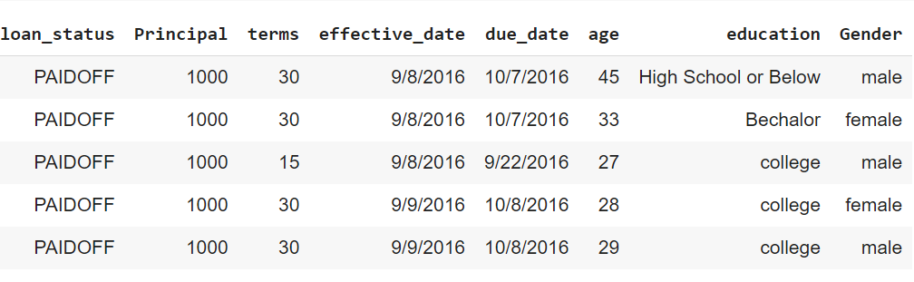
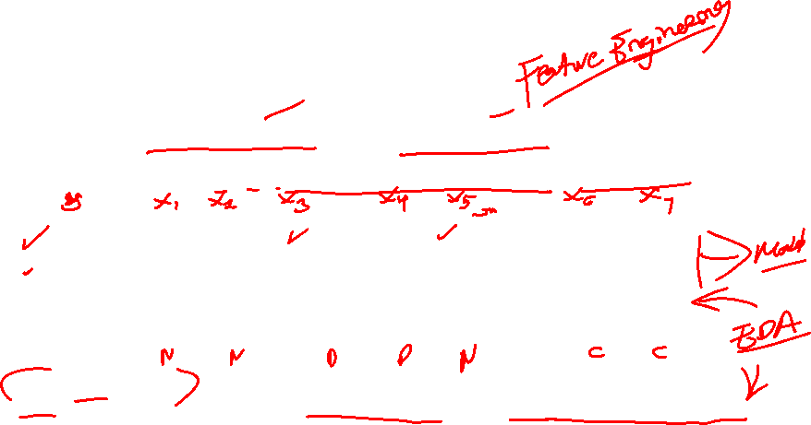
What are features in ML and Why FE is important
Data Preprocessing is essentially making your data into format useable by ML algorithms
Feature Engineering, however, involves using already existing variables to create new ones.
This is a process that relies heavily on domain knowledge and thorough exploration of one’s data.
Notes:
A feature is not just any variable in a dataset.
A feature is a variable that is important for predicting your specific target and addressing your specific question(s)
Preparing the proper input dataset, compatible with the machine learning algorithm requirements.
Improving the performance of machine learning models.

Slide 4
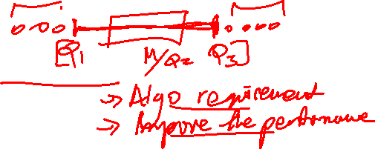
Techniques for Feature Processing
Scaling
Categorical Feature Encoding
Handling Outliers
Imputation
Handling Class Imbalance
Working with Text Features
Working with Images

Slide 5

Scaling

Slide 6
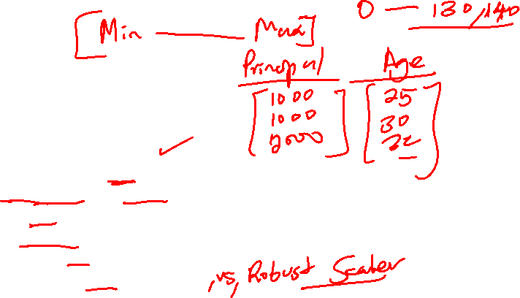
Scaling
Why Scaling is Important
Types of Feature Scaling
Normalisation (Min-Max Scaler)
Standardization
Robust Scaling
When to Use Scaling
Standardization vs Normalisation

Slide 7
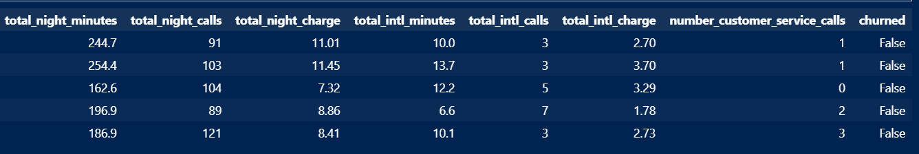
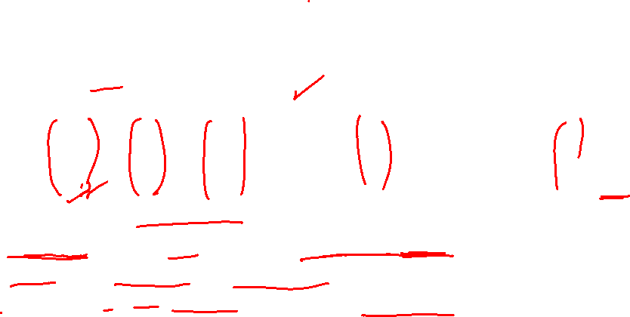
Why is Scaling Important
Algorithm Sensitivity : Distance based models like SVM, KNN can be included, and give biased results.
Convergence Speed: Algos like GD converge features are scaled and the minimum is reached faster
Interpretability : We need coefficients or importance scores assigned to features to be comparable.
Since we have the features have different scales, there is a chance that higher weightage is given to features with higher magnitudes.

Slide 8


Normalisation
Translating data to have a range [0,1]
Feature distribution is maintained
Notes:
Normalization is a scaling technique in which values are shifted and rescaled so that they end up ranging between 0 and 1. It is also known as Min-Max scaling

Slide 9

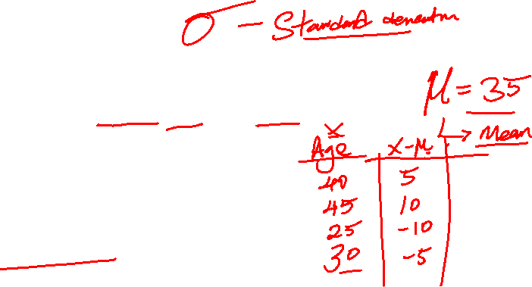
Standardization
Centering Data around the mean and unit standard deviation
Feature distribution is changed
Values are not restricted to a particular range
Notes:
You can always start by fitting your model to raw, normalized, and standardized data and comparing the performance for the best results.
It is a good practice to fit the scaler on the training data and then use it to transform the testing data. This would avoid any data leakage during the model testing process. Also, the scaling of target values is generally not required.

Slide 10
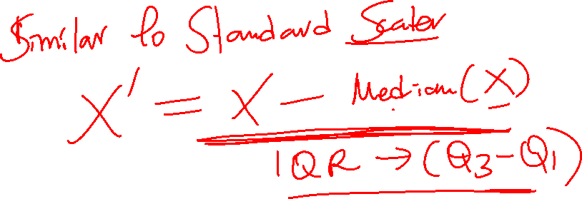
Robust Scaler

Slide 11
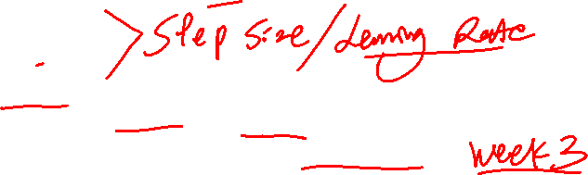
When to use Scaling
When using any model with gradient calculation (to find the minimum)
Linear Reg
Logistic Reg
ANN
Distance Based Algo’s : This is because, behind the scenes, they are using distances between data points to determine their similarity.
Note : Scaling is not Necessary for any Tree Based Algo
Notes:
The presence of feature value X in the formula will affect the step size of the gradient descent. The difference in the ranges of features will cause different step sizes for each feature. To ensure that the gradient descent moves smoothly towards the minima and that the steps for gradient descent are updated at the same rate for all the features, we scale the data before feeding it to the model.
Having features on a similar scale can help the gradient descent converge more quickly towards the minima.

Slide 12
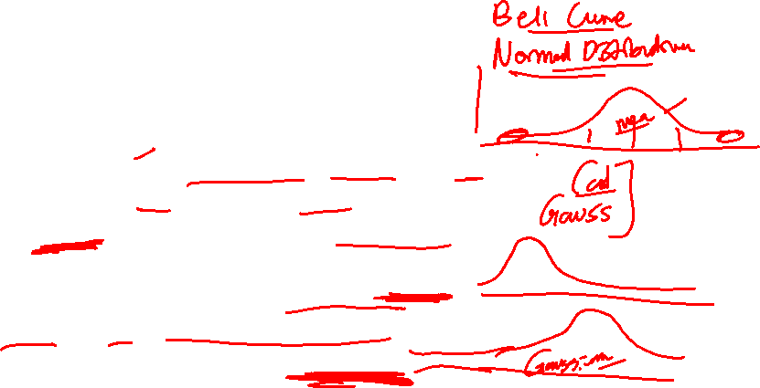
Normalisation Vs Standardization
Normalization : In algos that require same scale like GD, Neural Networks, and we don’t assume any distribution
Standardization : In case the features exhibit a Gaussian Distribution, When we have a lot of outliers.
Robust Scaler : This is similar to standard deviation, but uses median and IQR. It is more resilient to outliers. Useful for algos sensitive to outliers, for example SVM and KNN

Slide 13
Categorical Features

Slide 14
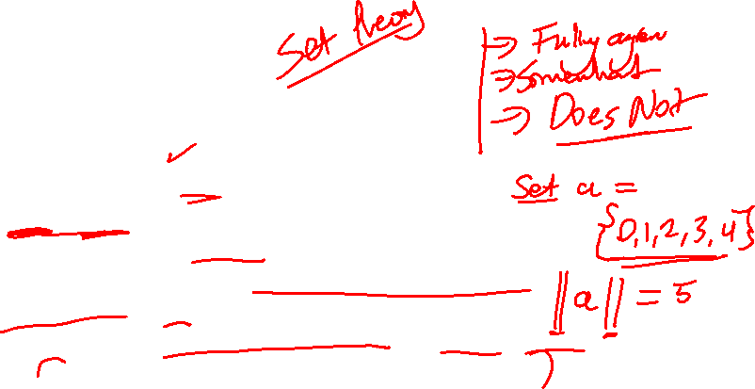
Types of Categorical Variables
Nominal Variables:
Categories with no intrinsic order (e.g., colors, gender).
Ordinal Variables:
Categories with a meaningful order (e.g., ratings, education level).
Understand the importance of preserving the order during encoding.
High-Cardinality Variables:
Categories with a large number of unique values (e.g., zip codes, product IDs).
Discuss the challenges and strategies for encoding these variables.

Slide 15
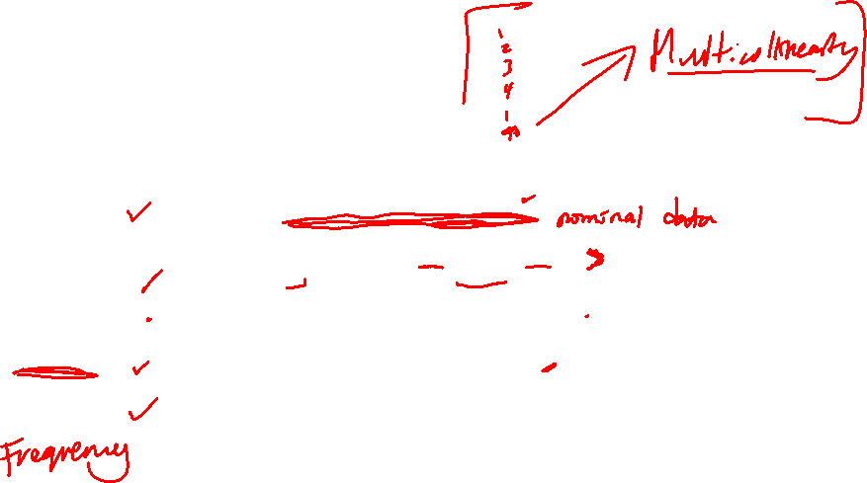
Types of Encoding Techniques
Encoding Method | Description
Label Encoding | Convert categorical labels into numeric values. Suitable for ordinal data where the order matters.
One-Hot Encoding | Convert categorical variables into a set of binary vectors. Ideal for nominal data where the order does not matter.
Ordinal Encoding | Assign a unique integer to each category in ordinal data.
Target Encoding | Encode categorical variables based on the target variable. Effective for high-cardinality categorical variables.
Binary Encoding | Combine the benefits of one-hot encoding and label encoding. Useful for reducing the dimensionality of high-cardinality features.

Slide 16
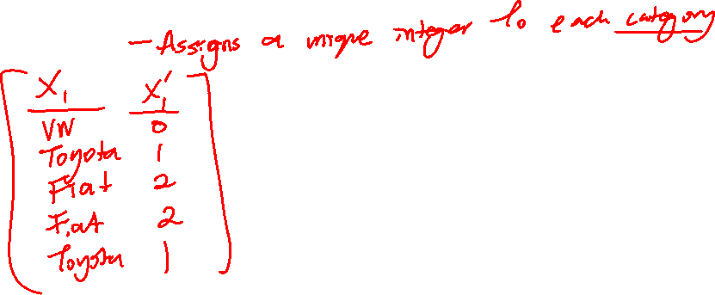
Types of Encoding Techniques
Label Encoding

Slide 17
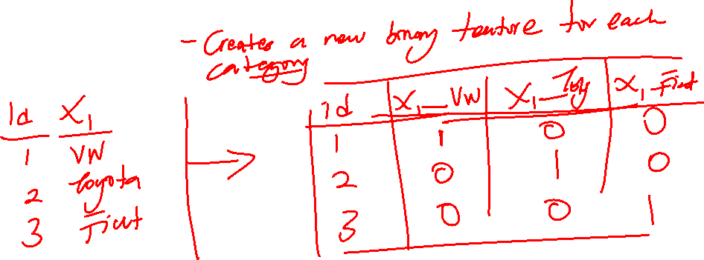
Types of Encoding Techniques
One-Hot Encoding

Slide 18
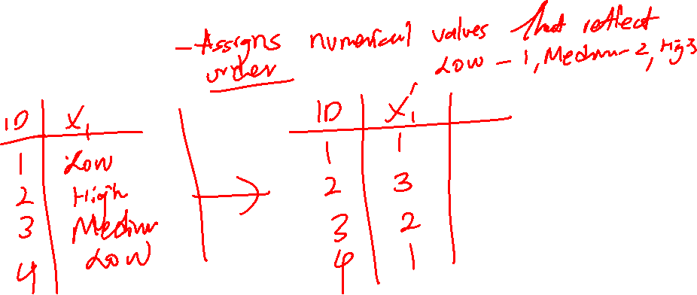
Types of Encoding Techniques
Ordinal Encoding

Slide 19
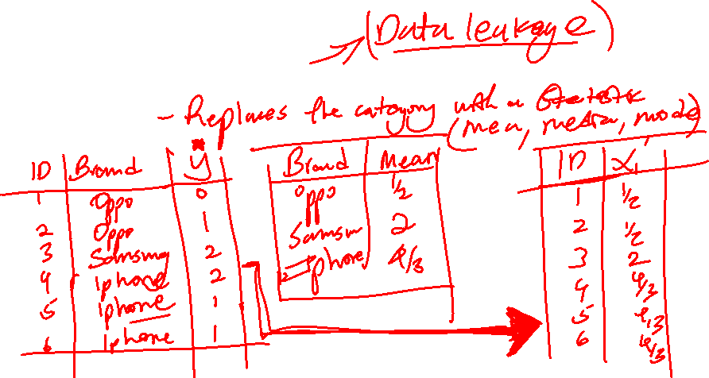
Types of Encoding Techniques
Target Encoding

Slide 20
Types of Encoding Techniques
Binary Encoding

Slide 21
Types of Encoding Techniques
Frequency Encoding

Slide 22
Missingness

Slide 23

Types of Data Missingness
Missing Completely at Random (MCAR)
Missing at Random (MAR)
Missing Not at Random (MNAR)

Slide 24
How to Deal with Missingness
Category | Method | Description
Deletion Methods | Listwise Deletion | Remove entire rows with missing values. Suitable for MCAR and when the proportion of missing data is small.
 | Pairwise Deletion | Use available data pairs for analysis.
Imputation Methods | Mean/Median/Mode Imputation | Replace missing values with the mean, median, or mode of the column. Ideal for MCAR and some cases of MAR.
 | Regression Imputation | Predict missing values using regression models based on other variables.
 | Multiple Imputation | Generate multiple datasets with imputed values and combine results. Effective for MAR and MNAR.
Advanced Techniques | K-Nearest Neighbors (KNN) | Use KNN to impute missing values based on similar observations.
 | Machine Learning Algorithms | Use machine learning models like Random Forest or XGBoost for imputation.

Slide 25
Imbalance

Slide 26
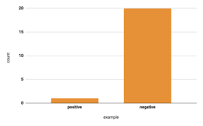
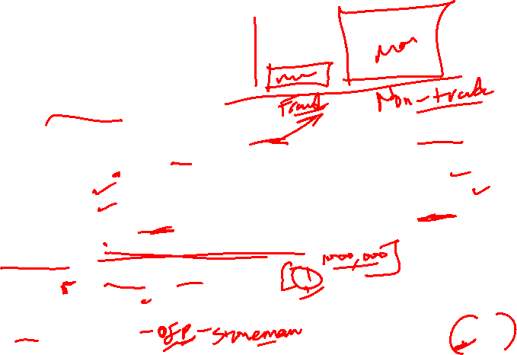
What is Class Imbalance
Before that, we have to define a few terms, that is The Positive and Negative Classes, The Minority and Majority Class
Percentage of data belonging to minority class | Degree of imbalance
20-40% of the dataset | Mild
1-20% of the dataset | Moderate
<1% of the dataset | Extreme
From <https://developers.google.com/machine-learning/crash-course/overfitting/imbalanced-datasets>
Examples of scenarios where we encounter class imbalance:
Detecting Fraud
Churn: Students, Customers, Employees
Recidivism
Defects in Manufacturing
Credit Risk : Most borrowers usually are low risk.
Rare Medical Conditions
Question : What issues arise when imbalanced datasets are not corrected?

Slide 27
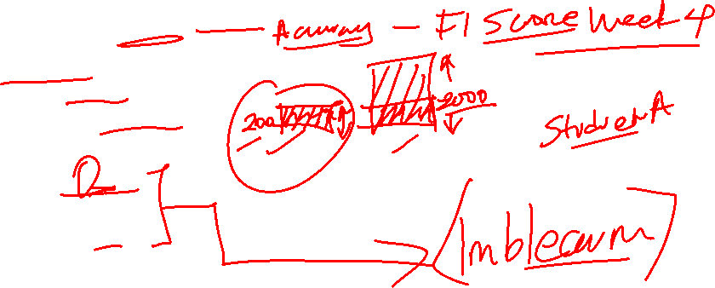
How do we deal with Class Imbalance
Use the right Evaluation Metrics
Resampling Techniques
Oversampling Techniques :
Random Oversampling
SMOTE
ADASYN
Notes:
https://towardsdatascience.com/class-imbalance-strategies-a-visual-guide-with-code-8bc8fae71e1a

Slide 28
Feature Pipelines

Slide 29
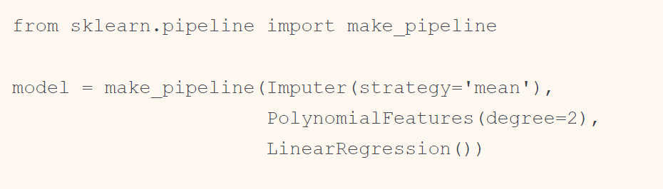
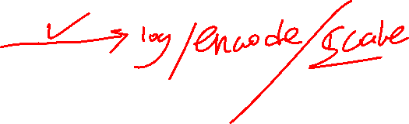
It can quickly become tedious to do the transformations by hand.
For example, we might want a processing pipeline that looks something like this:
Impute missing values using the mean
Transform features to quadratic
Fit a linear regression
This is where Scikit-Learn’s “Pipeline” Object comes in handy

Slide 30
Assignment Read on : 1. Dealing with Dates 2. Dealing with Text Features 3. Handling Images

Slide 31
End…

